Slide 1
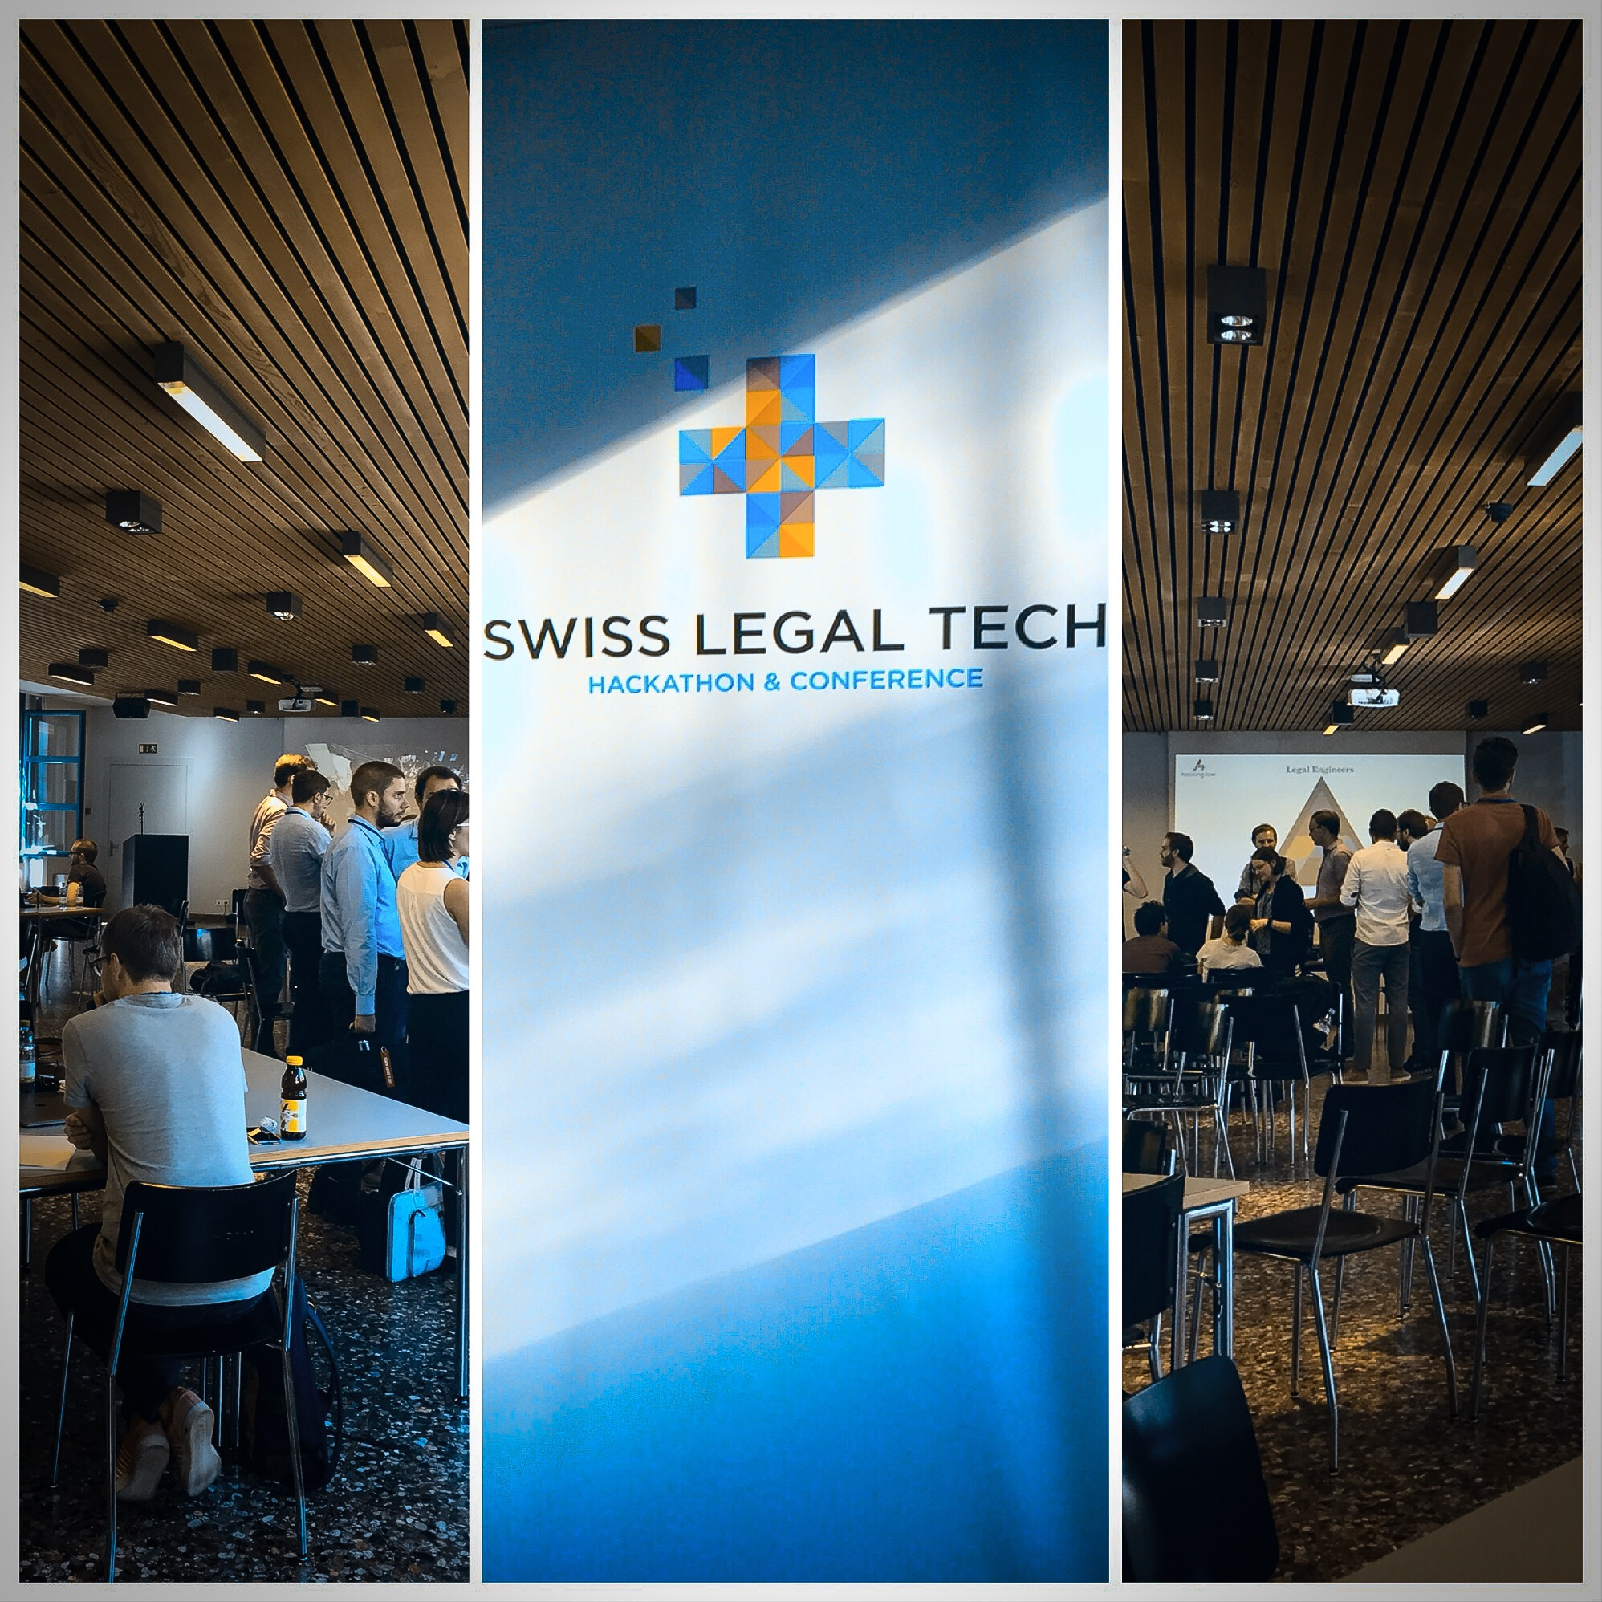

Slide 2
Dealing with
large & big cases

Slide 3





Case file

Slide 4


CaseTravel

Slide 5


Slide 6
Case Summary
2018
Jan
2018
Feb
2018
Mar

Slide 7
Case Summary
2018
Jan
Get your overview
of the case
2018
Feb
2018
Mar

Slide 8

Case Summary
Case Summary
NAMES
Silke Graf
Clemens Henökl
DATES
23.5.2018
12.6.2018
ARTICLES
Art 1 GDPR
§ 25 MSchG
NUMBERS
10
35
35.700
COURT
High Court
2018
Jan
2018
Feb
2018
Mar

Slide 9
Case Summary
NAMES
Silke Graf
Clemens Henökl
DATES
23.5.2018
12.6.2018
ARTICLES
Art 1 GDPR
§ 25 MSchG
NUMBERS
10
35
35.700
COURT
High Court
2018
Jan
Look for data categories & their values
2018
Feb
2018
Mar

Slide 10
Case Summary
NAMES
Silke Graf
Clemens Henökl
DATES
23.5.2018
12.6.2018
ARTICLES
Art 1 GDPR
§ 25 MSchG
NUMBERS
10
35
35.700
COURT
High Court
2018
Jan
2018
Feb
2018
Mar

Slide 11
Case Summary
NAMES
Silke Graf
Clemens Henökl
DATES
23.5.2018
12.6.2018
2018
Jan
2018
Feb
EVENT Summary
NAMES
Clemens Henökl
DATES
23.5.2018
2018
Mar

Slide 12
Case Summary
NAMES
Silke Graf
Clemens Henökl
DATES
23.5.2018
12.6.2018
2018
Jan
Tag important keywords
2018
Feb
EVENT Summary
NAMES
Clemens Henökl
DATES
23.5.2018
2018
Mar

Slide 13
Case Summary
NAMES
Silke Graf
Clemens Henökl
DATES
23.5.2018
12.6.2018
2018
Jan
Tag the keyword
“Clemens Henökl”
______________
Cancel Save
2018
Feb
EVENT Summary
NAMES
Clemens Henökl
DATES
23.5.2018
2018
Mar

Slide 14
Case Summary
NAMES
Silke Graf
Clemens Henökl (Witness)
DATES
23.5.2018
12.6.2018
2018
Jan
2018
Feb
EVENT Summary
NAMES
Clemens Henökl (Witness)
DATES
23.5.2018
2018
Mar

Slide 15



Forecast
Automatic trigger of further events (e.g. generation of documents)
Point to potential deadlines & automatic calculation
Open laws and decisions in the web by click
Adding personal notes to events & sharing them

Slide 16
CaseTravel
your timeline for
smart navigation
in legal cases

